Slide 1

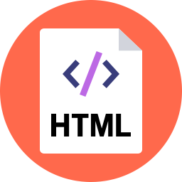
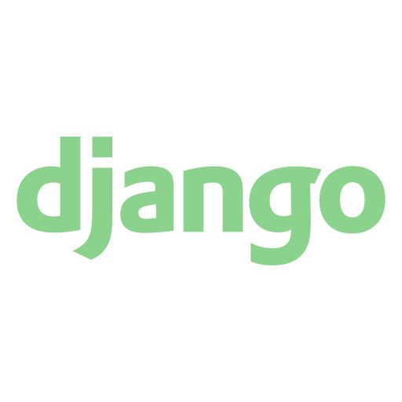
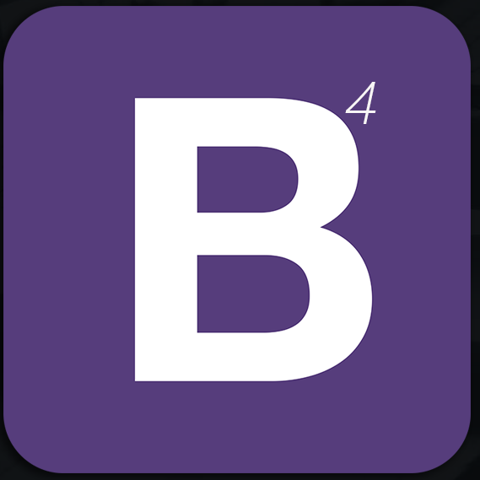
Web Development Using Django
Web development-APSSDC

Slide 2
Django Introduction
Django is a web development framework that assists in building and maintaining quality web applications.
Django helps eliminate repetitive tasks making the development process an easy and time saving experience.
It is a server side framework for developing dynamic websites.
Django makes it easier to build better web apps quickly and with less code.
Django is a Python-based free and open-source web framework that follows the model-view-template (MVT) architectural pattern.

Slide 3
History of Django
2003- started by Adrian Holovaty and Simon Willison as internal project at the Lawrence journal world newspaper.
2005- publicly released under BSD license in 21, July 2005 and named it Django.
Currently, DSF (Django Software Foundation) maintains its development and release cycle.
Django is now an open source project with contributors across the world.

Slide 4
Advantages of Django
Object-Relational Mapping (ORM) Support − Django provides a bridge between the data model and the database engine, and supports a large set of database systems including SQLITE3,MySQL,NOSQL..etc. It’s very easy to switch database in Django framework.
Administration GUI − Django provides a nice ready-to-use user interface for administrative activities.It has built-in admin interface which makes easy to work with it.
Development Environment − Django comes with a lightweight web server to facilitate end-to-end application development and testing.
Less Coding − Less code so in turn a quick development.
Don't Repeat Yourself (DRY) − Everything should be developed only in exactly one place instead of repeating it again and again.
Fast Development − Django's philosophy is to do all it can to facilitate hyper-fast development.

Slide 5
Popularity of Django
Django is widely accepted and used by various well-known sites such as:
Instagram
Mozilla
Disqus
Pinterest
Bitbucket
The Washington Times

Slide 6
Features of Django
Rapid Development: Django was designed with the intention to make a framework which takes less time to build web application.
Secure: Django helps developers to avoid many common security mistakes.Its user authentication system provides a secure way to manage user accounts and passwords.
Scalable: Django is scalable in nature and has ability to quickly and flexibly switch from small to large scale application project.
Open Source: Django is an open source web application framework. It is publicly available without cost. It can be downloaded with source code from the public repository.
Vast and Supported Community: Django is an one of the most popular web framework. It has widely supportive community and channels to share and connect.

Slide 7
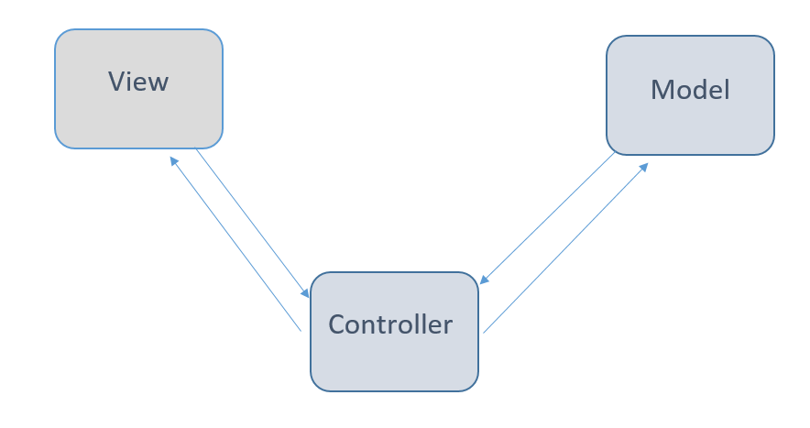
Django MVC - MVT Pattern
Django follows the model-view-template (MVT) architectural pattern. The Model-View-Template (MVT) is slightly different from MVC.
MVC Pattern:When talking about applications that provides UI (web or desktop) we usually talk about MVC architecture. And as the name suggests, MVC pattern is based on three components: Model, View, and Controller.
Model: In model we write our database logics.
Controller: In controller we will write main logic for controlling views and models.
View: in view we build logic to navigate .html files(UI)

Slide 8
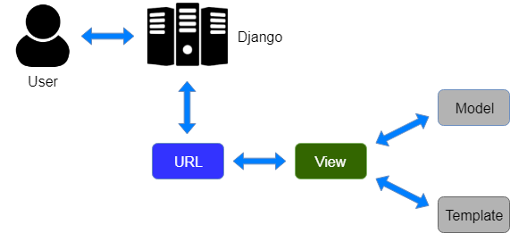
Django MVT Pattern
Model: Model is going to act as the interface of your data. It is responsible for maintaining database connections
View: In Django, Views are responsible for handling all the business logic behind the web app. It acts as a bridge between Models and Templates
Template: Django Templates are responsible for the entire User Interface completely. It handles all the static parts of the webpage along with the HTML file mixed with Django Template Language (DTL).
The main difference between MVC and MVT patterns is that Django itself takes care of the Controller part .

Slide 9
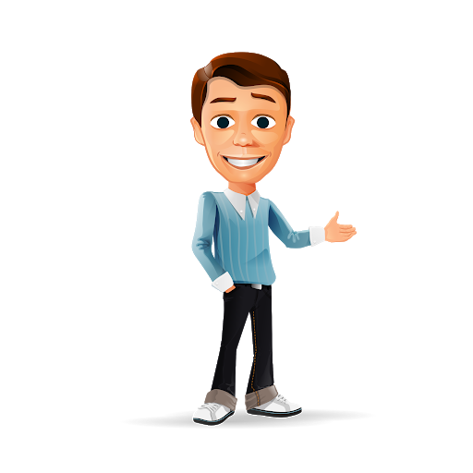
Thank you
Slides created, maintained and distributed by Web development - Andhra Pradesh State Skill Development Corporation (All these Slides are open source)

